Slide 1

Project Presentation
Title:
Loan Accessibility (LA) Model
Predicting Creditworthiness for Informed Lending
By
Ibediogwu Promise Ekele
August 2024

Slide 2
Methodology: Case Study - Non-banking financial institution (NBFI)
Phases Involve:
Introduction: Understanding Business Problem
Analytic Approach
Data Requirement and Data Collection
Data Understanding
Exploratory Data Analysis
Data Cleaning and Data and Preprocessing.
Modelling and Evaluation
Deployment/Implementation
Conclusion/Recommendation

Slide 3
Understanding Business Problem
NBFI is a non-bank financial company, it is a type of financial institution that is not authorized to operate as a bank or is not under the supervision of a banking regulatory agency at the national or international level. NBFIs provide financial services similar to those of banks, such as investment, risk pooling, contractual savings, and market brokering. which is currently facing profitability issues due to an increase in defaults in the vehicle loan category.
Goal/Aim
The company aims to assess the loan repayment ability of clients and determine the relative importance of each factor contributing to a borrower's ability to repay the loan.
Objective
Develop a model using the Train_Dataset and testing the model on the Test_Dataset and predict whether a client is likely to default on their vehicle loan payment or not
Determine the relative importance of each factor contributing to a borrower's ability to repay the loan.

Slide 4
Analytic Approach
The stated problem can be solved using various Machine Learning classifiers because it is a Classification Problem.
The various Machine Learning algorithms will be used, evaluated, and cross-validate to know the best based on their different accuracy values or scores.
The features will be examined to determine which is the one that has the greatest effect on the Song Classification.
Machine Learning Classifiers such as:
Decision Tree
Logistic Regression
GaussianNB
Random Forest
K-Nearest Neighbor
Xgboost Classifier
LightGboost

Slide 5
Data Requirement and Data Collection
The required data for this problem is the dataset that contains the financial record of the client, the family records, and properties owned by the client.
The Dataset should contain vital information about the client., this will help in predicting whether the client will default in repaying of the loan.
The Dataset that will be used in this Problem is the Vehicle Loan Repayment Dataset from NBFI. Source: https://www.kaggle.com/datasets/meastanmay/nbfi-vehicle-loan-repayment-dataset/data.
The Dataset consists of two types:
Train_Dataset.csv for model building and evaluation.
Test_Dataset.csv for prediction.

Slide 6
Data Understanding
Data Description:
From the provided data set i.e the “Train_Dataset.csv” and the “Test_Dataset.csv”, we shall be using just the “Train_Dataset.csv”.
The dataset contains the dependent and the independent features:
Dependent: Default (0 and 1)
Independent: Contains both the financial record, family records, proper record and other personal features from the clients
In total, the dataset contains 121856 entries categorized into 2 categories, with 39 different independent features.

Slide 7
Data Understanding (con’t)
More information about the dataset.
Independent features:
ID: Client Loan application ID
Client_Income: Client Income in USD
Car_Owned: Any Car owned by client before applying for the loan for another car (0 means No and 1 means otherwise)
Bike_Owned: Any bike owned by client (0 means No and 1 means otherwise)
Active_Loan: Any other active loan at the time of application of loan (0 means No and 1 means otherwise)
House_Own: Any house owned by client (0 means No and 1 means otherwise)
Child_Count: Number of children the client has
Credit_Amount: Credit amount of the loan in USD.
Loan_Annuity: Loan annuity in USD
Accompany_Client: Who accompanied the client when client applied for the loan
Client_Income_Type: Clients income type.

Slide 8
Data Understanding (con’t)
Client_Education: Highest level of education ahieved by client, Client_Marital_Status: Marital status of client (D- Divorced, S- Single, M- Married, W- Widowed)
Client_Gender: Gender of the Client, Loan_Contract_Type: Loan Type (CL- Cash Loan, RL- Revolving Loan)
Client_Housing_Type: Client Housing situation
Population_Region_Relative: Relative population of the region where the client is living. Higher value means the client is living in more populated area
Age_Days: Age of the client at the time of application submission
Employed_Days: Days before the application, the client started earning
Registration_Days: Days before the loan application, the client changed his/her registration
ID_Days: Days before the loan application, the client changed his/her identity document with which the loan was applied.
Own_House_Age: Age of Client's house in years, Mobile_Tag: Mobile Number provided by Client (1 means Yes and 0 means No)
Homephone_Tag: Homephone Number provided by Client (1 means Yes and 0 means No)

Slide 9
Data Understanding (con’t)
Workphone_Working: Was workphone number reachable (1 means Yes and 0 means No), Client_Occupation: Client Occupation type., Client_Family_Members: Number of family members does client have., Cleint_City_Rating: Client city rating. 3 denotes best and 2 denotes good and 1 denotes average.
Application_Process_Day: Day of the week on which client applied for the loan (0-Sun, 1-Mon,2-Tues, 3-Wed, 4-Thrus,5-Fri, 6-Sat)
Application_Process_Hour: hour of the day on which client applied for the loan
Client_Permanent_Match_Tag: Indication if client contact address does not match permanent address.
Client_Contact_Work_Tag: Indication if client work address does not match contact address.
Type_Organization: Type of organization where client works
Score_Source_1, 2, 3: Score sourced from other source(3). This is a normalzied score

Slide 10
Data Understanding (con’t)
Social_Circle_Default: How many friends/family members of the client defaulted on any loan payment in the last 60 days
Phone_Change: How many days before the loan application, the client changed his/her phone
Credit_Bureau: Total number of inquiries in last year
Dependent feature:
This is the Default feature which depends largely on the independent features, this feature tells if the client is creditworthy or not, whether the client will default in repayment or not
Comprise of 2 categories:
Default: 1 means the client defaulted on loan payments and 0 means otherwise.

Slide 11
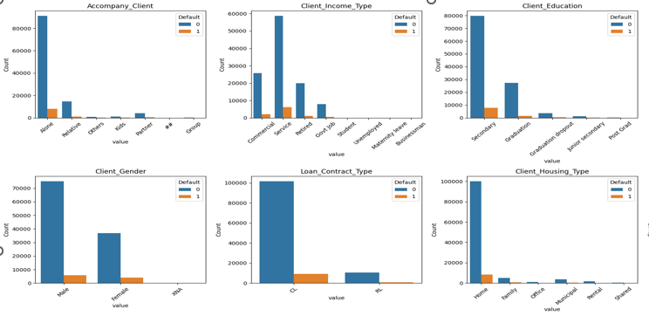
Exploratory Data Analysis
Data Visualization:
Distribution of the client across he Target label using barplot

Slide 12
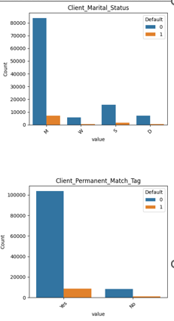
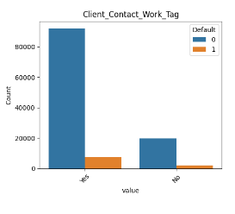
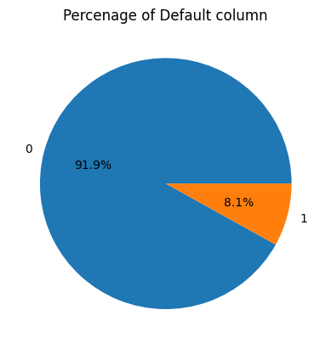
Exploratory Data Analysis (con’t)
Data Visualization:
Distribution of the client across he Target label using barplot

Slide 13
Exploratory Data Analysis (con’t)
Insight from the Analysis:
91.9% of the dataset, contains non-defaulter, while 8.1% contains defaulters, this is to say the dataset is imbalance.
We also observed that those clients that came alone default more.
Above all, hose client who are of the service type income default more.
Also clients who has secondary school as their education level default more from our dataset.
Also from our dataset male defaulters are more than female.
Also the CL Loan_conract_type defaulters are more in our dataset.
Married client defaulters are more in our dataset.
The dataset contains outliers from the numerical features.

Slide 14
Data Cleaning and Data and Preprocessing.
Data Cleaning:
During the data cleaning process the following was done .
The ID column was made the index id of the dataset, because it contains an ordered arrangement of all the records in the dataset.
We checked for missing values if their are any using df.info(), it was noticed that there were lots of missing values, the following columns were dropped since their missing values were more than 50% of that columns: 'Score_Source_1','Score_Source_3','Social_Circle_Default’ and Client_occupation.
The numerical columns were also cleaned because it contained so social character which made them not to be of numeric format.
We also checked if there were any duplicates, using the function, df.duplicated().sum(), there was 1159 duplicate in the dataset.

Slide 15
Data Cleaning and Preprocessing. (con’t)
Data Preprocessing:
Scaling of the Dataset
During this phase, the dataset was preprocessed using the Robust scaler to scale the dataset because of the presence of outliers to help the model perform better.
Feature Encoding:
Label Encoding was used to encode the categorical features
Feature Engineering
During the feature engineering phase of data preprocessing, new features were created to improve the performance of the model.

Slide 16
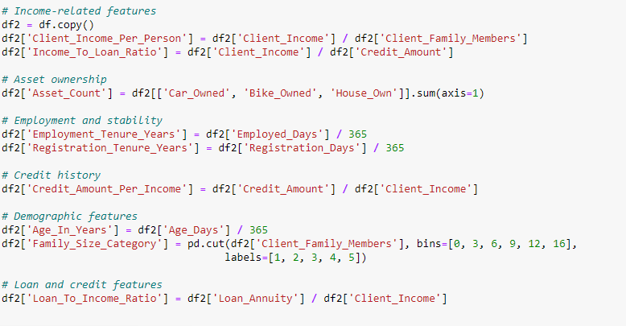
Data Cleaning and Preprocessing. (con’t)
Feature Engineering (con’t)
The following features were created:
Note: the feature engineering did not import the model performance so it wasn’t used for the conclusion

Slide 17
Modelling and Evaluation
Modelling:
The dataset was split into a train set (80%) and a test set (20%) using train_test_split sklearn.model_selection library, the dataset split was also stratified.
The Train set was fitted into the following Machine Learning classifiers:
Decision Tree
Logistic Regression
GaussianNB
Random Forest
K-Nearest Neighbor
Xgboost Classifier
LightGBM

Slide 18
Modelling and Evaluation (con’t)
Evaluation:
After Building the model classifiers, the test set is then used to evaluate the score of the Model to obtain the best model out of all the models used.
Machine Learning models can be evaluated using different evaluation techniques.
The model can be evaluated using the Accuracy score, Confusion Matrix, or ROC AUC value:
The model with the optimal accuracy score, type 1 and type 2 Error, optimal F1- accuracy score, ROC AUC value is the best model.
Note: Evaluation metrics are used based on the nature of the given dataset and in this problem, the ROC AUC evaluation metric, was preferred because our dataset is imbalanced.

Slide 19
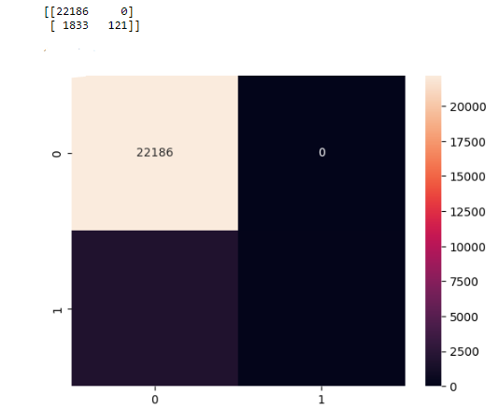
Modelling and Evaluation (con’t)
Result The following model gave an optimal ROC-AUC value of above 70%, the Randome Forest (0.7249) proved to be the best compare to others:
1. Random Forest (0.7249)
3. Catboost (0.7069)
4. XGBoost (0.7012)
5. LightGBM (0.7040)
Confusion Matrix

Slide 20
Modelling and Evaluation (con’t)
Cross-validation: This is a process whereby the model is tested with various folds or portions of the test dataset to validate its accuracy.
Our models with ROC-AUC value above 0.70 were cross-validated using the cross-validate function sklearn.model, and the test set was split into 5 folds. Below is the mean accuracy for all the classifiers:
1. Random Forest ----------------------------- 0.5292
3. Catboost ------------------------------------- 0.5060
4. XGBoost ------------------------------------ 0.5084
5. LightGBM ---------------------------------- 0.5019

Slide 21
Deployment/Implementation
After evaluating the model and getting the right model for the problem, the next thing to do is to implement the model in the stated problem to achieve the goal and objective stated.
Pipelining: After cross-validating the model, a pipeline class was created for the Random Forest model, in pipelining, all the processes were fixed together in a file so it could be ready for deployment and to make prediction.

Slide 22
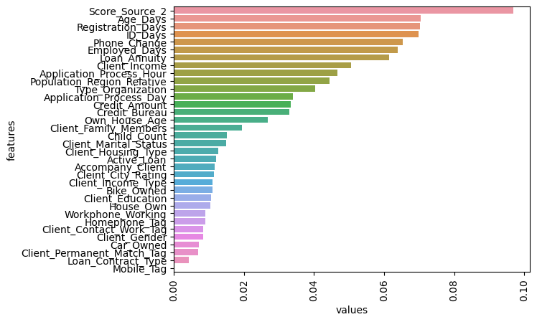
Conclusion.
The goal which is to build a model to categorize songs into four main emotions, which is the Random Forest classifier.
Importance features:
From the feature importance, we can ascertain that the score_source_2 feature is the most important feature to our model, followed by the Age_Days down to the Client_income feature which became among the top 10 features that are important to the model.

Slide 23
Recommendation
There is room for improvement in the model performance, the model can be fine-tuned, more records can be added to solve imbalanced problems, and more features can be generated to get more optimal accuracy.

Slide 24
Thank You.

